Slide 1
Library Management System
A library management system (LMS) is a software application that helps librarians manage and organize library resources such as books, and others.

Slide 2
why LMS is necessary
Efficient management of resources
Improved data accuracy
Increased productivity

Slide 3
Benefits of using an LMS
Improved efficiency: An LMS automates routine tasks such as cataloging, circulation, and reporting, saving librarians time and reducing errors.
Increased productivity: An LMS can increase productivity by automating routine tasks and reducing the time spent on manual processes, allowing librarians to focus on more strategic and value-added activities.
Accurate data: An LMS helps ensure that data is accurate and up-to-date, reducing the risk of errors and inaccuracies that can lead to lost resources, delayed checkouts, and unsatisfied patrons.

Slide 4
Technology used
Flask.is a lightweight and flexible python web framework that allows developers to quickly and easily create web applications.
It provides a set of tools and utilities that allow developers to define routes and handle http requests, manage sessions and cookies,and interact with databases,and it support functionality such as authentication,security,and data validation
It is simple,ease of use ,highly customizable,

Slide 5
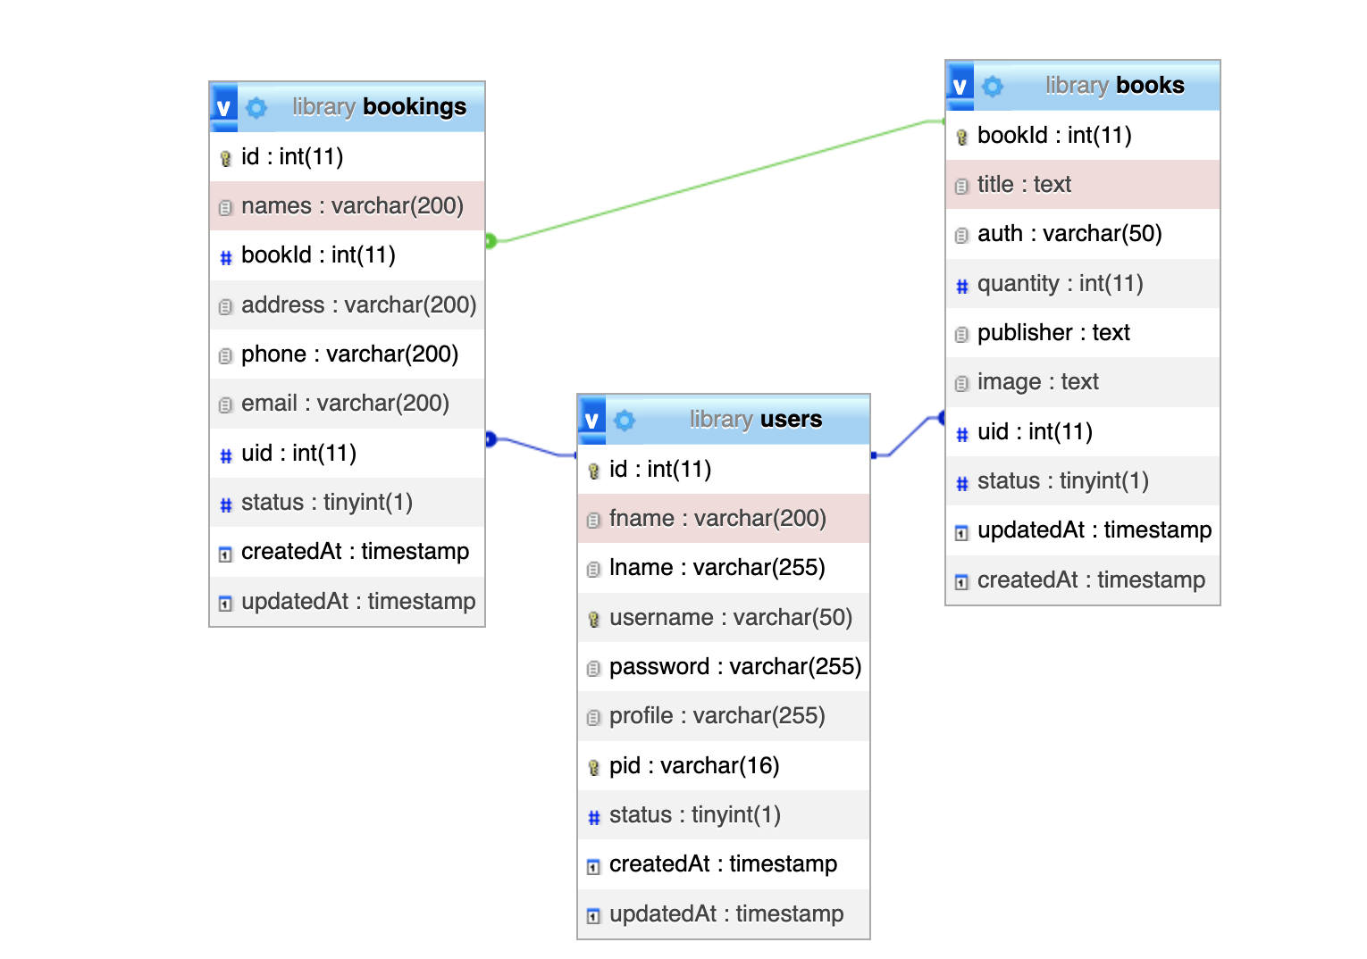
Database structure

Slide 6
Summary
Library management system is a software application designed to help manage various aspects of a library, including circulation of books, managing library users and trucking library resources.

